Slide 1


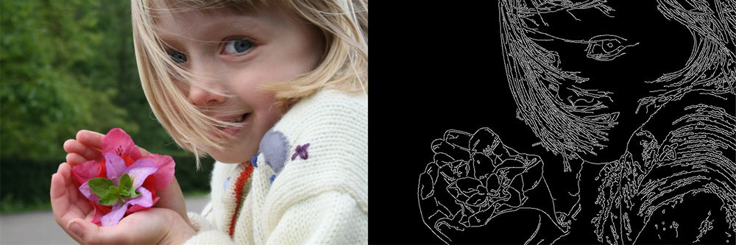
Ανίχνευση Ακμών

Slide 2
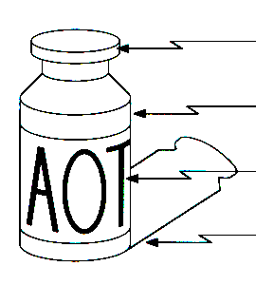
Τι θα δούμε σήμερα;
surface normal discontinuity
Ανίχνευση ακμών
Τι είναι & που χρησιμεύει
Ανίχνευση με κατωφλίωση και παραγώγιση
Ανίχνευση με συνέλιξη
Συνήθεις τεχνικές
Sobel edge detector
Laplacian edge detector
Canny edge detector
depth discontinuity
surface color discontinuity
illumination discontinuity
https://medium.com/@nikatsanka/comparing-edge-detection-methods-638a2919476e

Slide 3
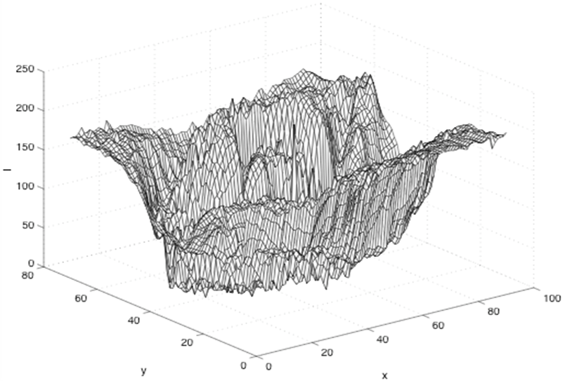
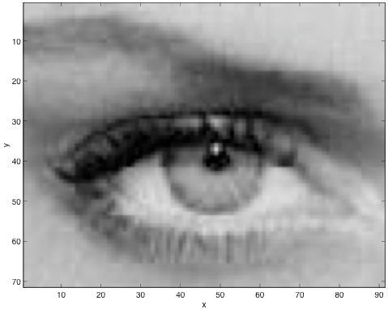
Η ιδέα
Ξεκινάμε με περιοχές όπου αλλάζει η κλίση

Slide 5
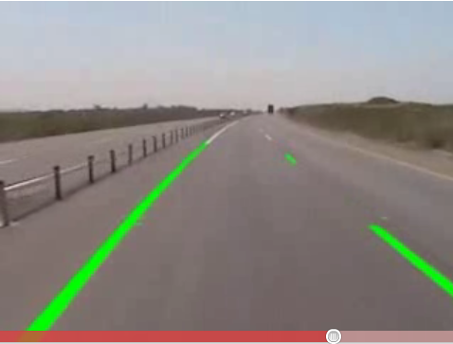
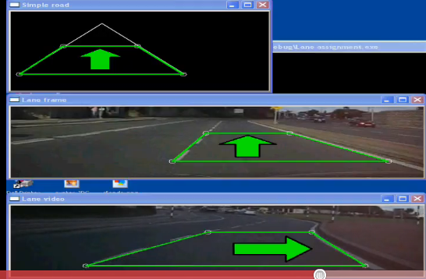
Παράδειγμα: Ανίχνευση λωρίδας κυκλοφορίας
https://www.youtube.com/watch?v=Al4DnNkZUeA&feature=related&ab_channel=WeiLiu

Slide 6




Είδη ακμών
step
roof
ramp
spike

Slide 7
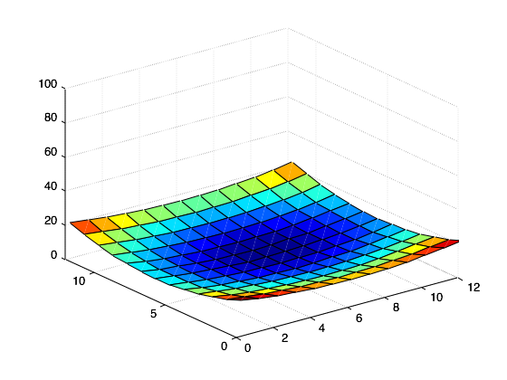
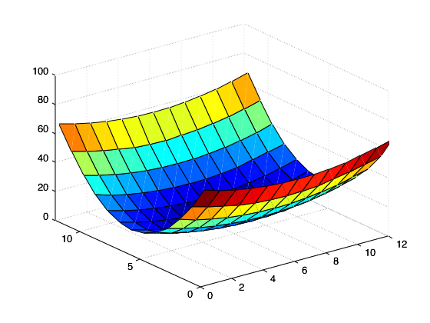
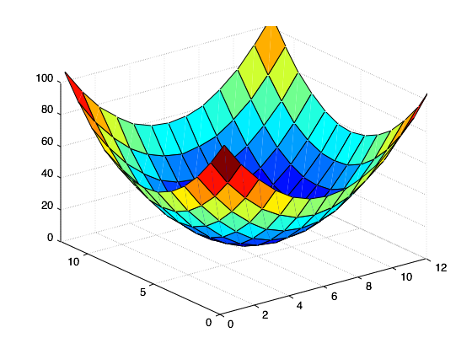
Σχέση σημείων σε εικόνα με εξαγωγή χαρακτηριστικών
flat
edge
‘line’
corner
‘dot’

Slide 8
Πως υπολογίζουμε τις ακμές;
I(x,y+1) I(x+1,y+1)
I(x,y) I(x+1,y)
Use gradient G of intensity [I(x,y)] change, two methods
First order gradient
I(x,y) is an edge if
Second order gradient (Laplacian operator)
I(x,y) is an edge if
I(x,y)
y
x

Slide 9
Με απλά λόγια
I(x,y)
Ελέγχω την μεταβολή της φωτεινότητας κατά μια διεύθυνση
x
1^{η} παράγωγος: ελέγχουμε αν περνάει κάποια τιμή
x
2^{η} παράγωγος: ελέγχουμε αν μηδενίζει
x

Slide 10
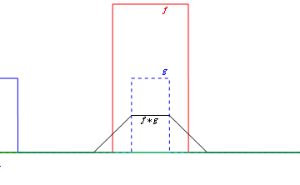
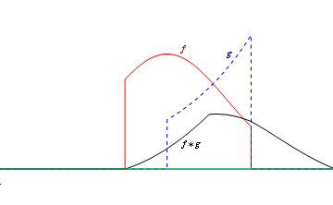
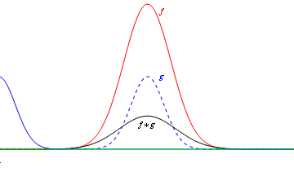
Εναλλακτικός τρόπος: συνέλιξη
Βοχ
Exponential_and_Gaussian
Gaussian
Εκτελούμε την πράξη της συνέλιξης μεταξύ μιας προκαθορισμένης μάσκας και της εικόνας

Slide 11
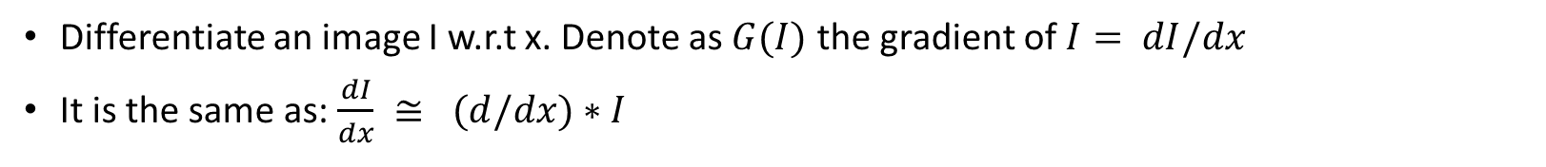
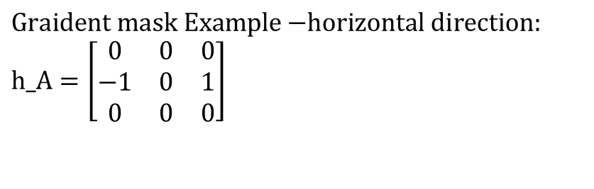
Ωπα! Πως πήγαμε από παράγωγο σε συνέλιξη;
Differentiate an image I w.r.t x. Denote as $G(I)$ the gradient of $I= dI/dx$
It is the same as: $\frac{dI}{dx} ≅ (d/dx)∗I$
Gradient mask or filter mask
(*) = Convolution operator
$$\text{Graident} \text{mask} \text{Example}\text{ −}\text{horizontal} \text{direction}\text{:} \\ \text{h}\text{_}\text{A}=\left[\begin{matrix}0 & 0 & 0 \\ \text{−1} & 0 & 1 \\ 0 & 0 & 0\end{matrix}\right]$$

Slide 12
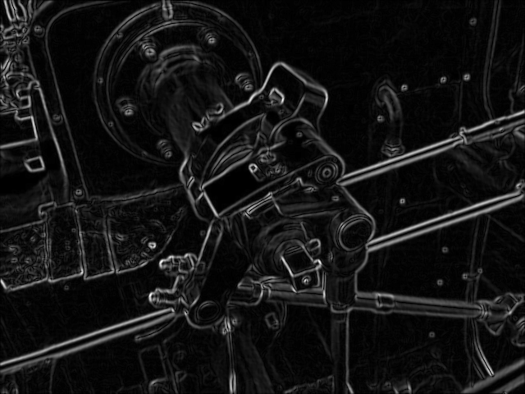
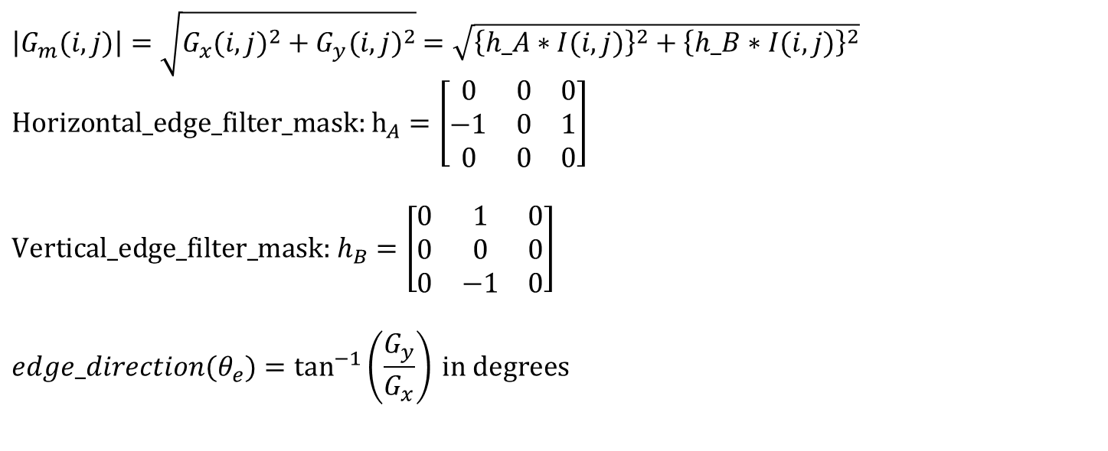
Έχει κάποιο πλεονέκτημα;
Βασική υπόθεση: τα Gx,Gy είναι διαχωρίσιμα (separable). Τότε, το gradient Gm υπολογίζεται από τα:
Horizontal gradient, $Gx(i,j)= h_{A}∗I(i,j)$ και vertical gradient, $Gy(i,j)= h_{B}∗I(i,j)$
$\left|G_{m}(i,j)\right|=\sqrt{G_{x}(i,j)^{2}+G_{y}(i,j)^{2}}$ $=\sqrt{{\left\{h_A∗I(i,j)\right\}}^{2}+{\left\{h_B∗I(i,j)\right\}}^{2}}$
$$\text{Horizontal}\text{_}\text{edge}\text{_}\text{filter}\text{_}\text{mask}\text{: }{\text{h}}_{A}=\left[\begin{matrix}0 & 0 & 0 \\ \text{−1} & 0 & 1 \\ 0 & 0 & 0\end{matrix}\right]$$
$$\text{Vertical}\text{_}\text{edge}\text{_}\text{filter}\text{_}\text{mask}\text{: }h_{B}=\left[\begin{matrix}0 & 1 & 0 \\ 0 & 0 & 0 \\ 0 & \text{−1} & 0\end{matrix}\right]$$ $$edge_direction(θ_{e})=\tan^{−1}\left(\frac{G_{y}}{G_{x}}\right) \text{in} \text{degrees}$$
θ_{e}
An edge is found and direction is tan⁻¹(Gy/Gx)=θ_{e}

Slide 13


1-D convolution examples

Slide 14


Sobel edge detection

Slide 15
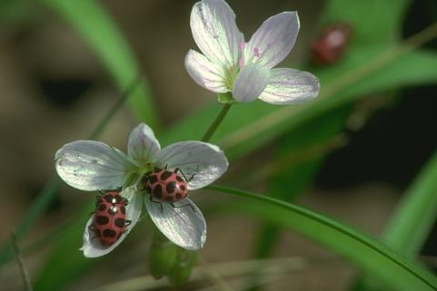

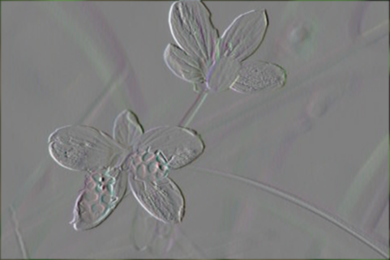
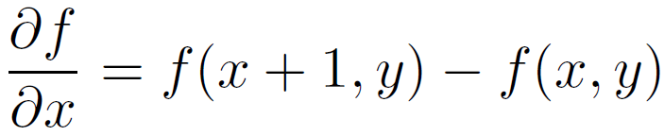

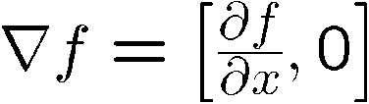
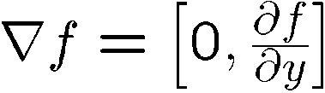
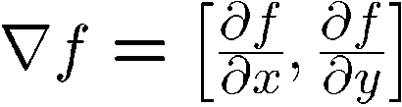
Image gradient
The gradient of an image:
The gradient points in the direction of most rapid change in intensity

Slide 16
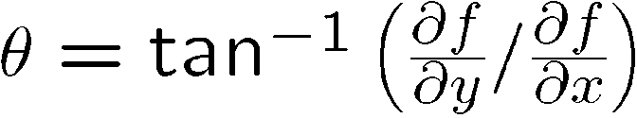

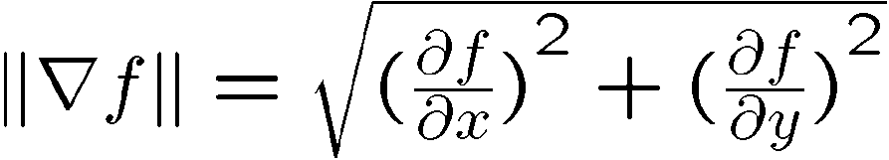
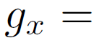
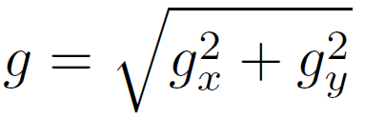
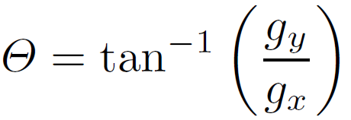
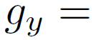
Από gradients στον Sobel
The gradient direction is given by:
How would you implement this as a filter?
How does this relate to the direction of the edge?
The edge strength is given by the gradient magnitude
Magnitude:
Orientation:
-1 | 0 | 1
-2 | 0 | 2
-1 | 0 | 1
-1 | -2 | -1
0 | 0 | 0
1 | 2 | 1

Slide 17
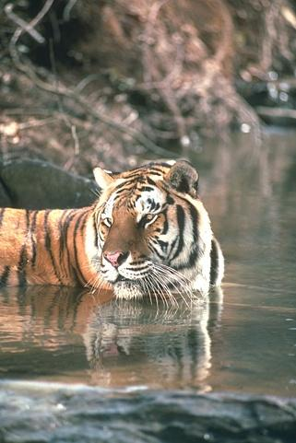
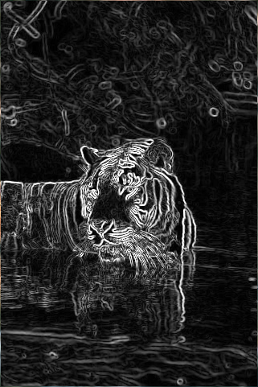
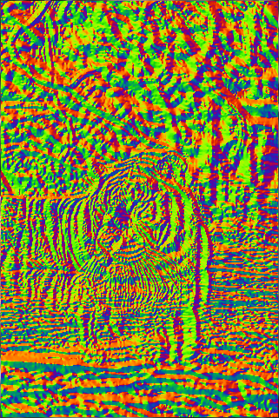
Sobel operator
Original
Magnitude
Orientation

Slide 18
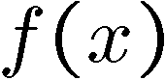
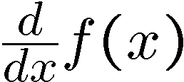
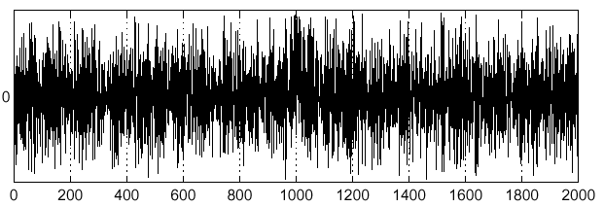
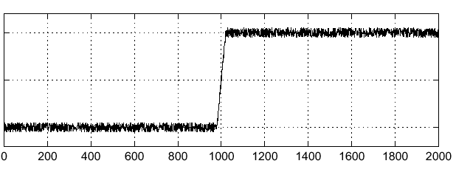
Effects of noise
Consider a single row or column of the image
Plotting intensity as a function of position gives a signal
Where is the edge?

Slide 19
Effects of noise
Difference filters respond strongly to noise
Image noise results in pixels that look very different from their neighbors
Generally, the larger the noise the stronger the response
What can we do about it?

Slide 20


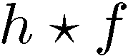
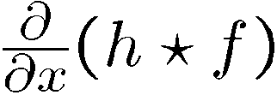
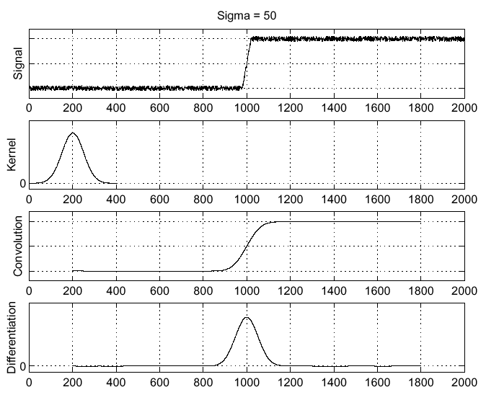
Solution: smooth first
Where is the edge?
Look for peaks in

Slide 21
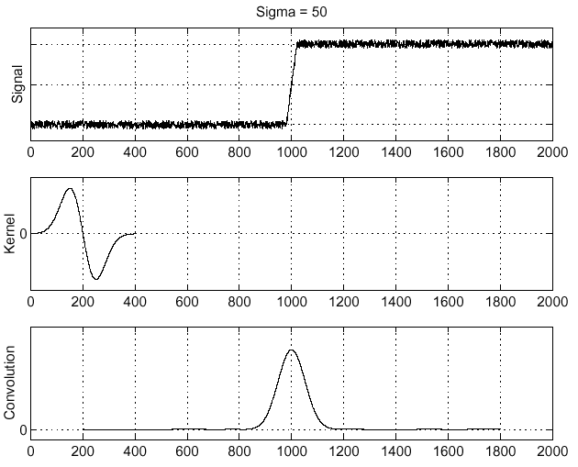
Derivative theorem of convolution
Differentiation is convolution, and convolution is associative:
This saves us one operation:
f
How can we find (local) maxima of a function?
Source: S. Seitz

Slide 22
Laplacian edge detection

Slide 23
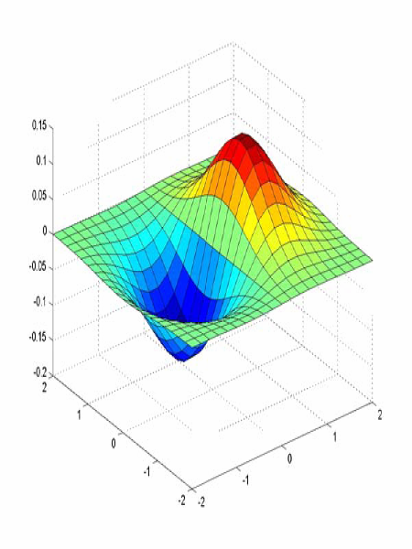
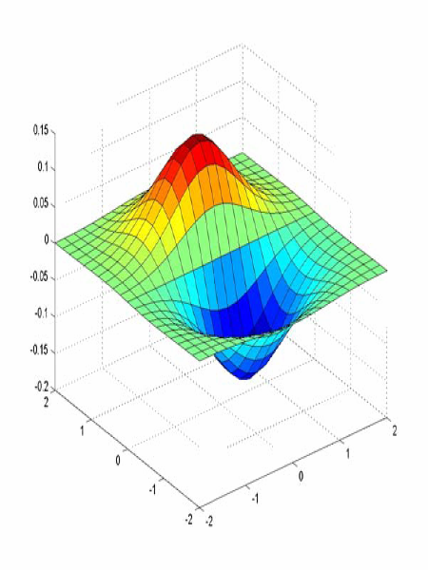
Υπενθύμιση: Derivative of Gaussian filter
x-direction
y-direction

Slide 24
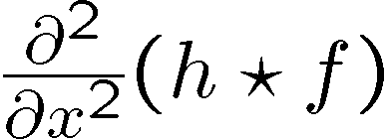
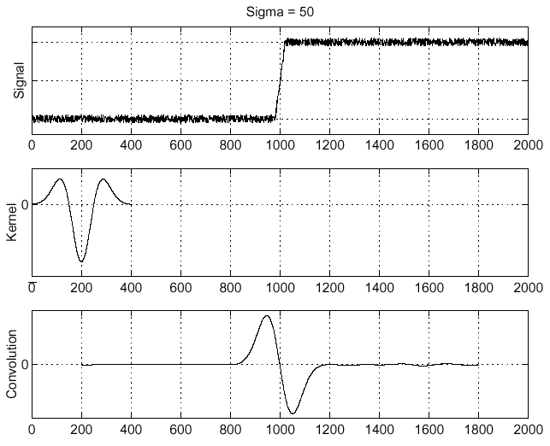
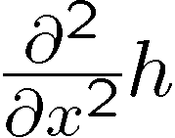
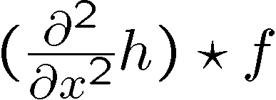
Laplacian of Gaussian
Consider
Laplacian of Gaussian
operator
Where is the edge?
Zero-crossings of bottom graph

Slide 25
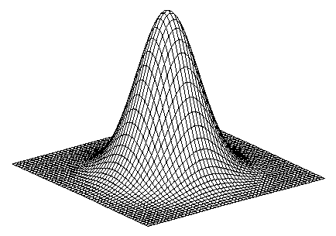
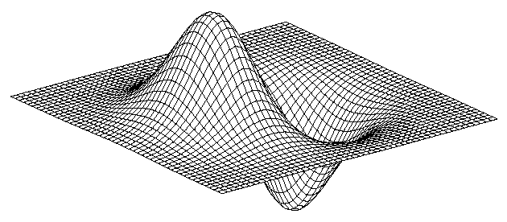
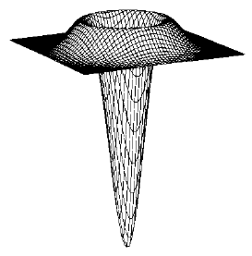
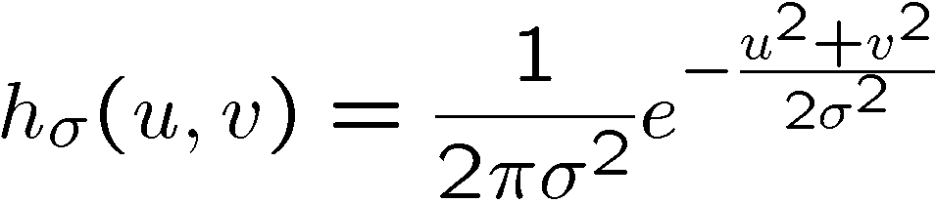
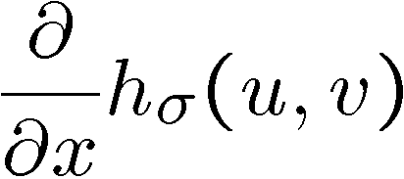



2D edge detection filters
Laplacian of Gaussian
Gaussian
derivative of Gaussian
is the Laplacian operator:
Notes:
How many 2nd derivative filters are there? There are four 2nd partial derivative filters.
In practice, it’s handy to define a single 2nd derivative filter—the Laplacian

Slide 26

Edge detection by subtraction
original

Slide 27

Edge detection by subtraction
smoothed (5x5 Gaussian)

Slide 28

Edge detection by subtraction
Why does
this work?
smoothed – original
(scaled by 4, offset +128)

Slide 29

Gaussian - image filter
Ωπ! Τι σου θυμίζει;
Gaussian
delta function
Laplacian of Gaussian

Slide 30

Άλλο ένα παράδειγμα Λαπλασιανής
Top left: Original image.
Top right: After Gaussian blur filter.
Bottom Left: Apply Laplacian filter on the blurred image.
Bottom right: Edge after zero crossing

Slide 31
Canny edge detection

Slide 32
Canny Edge Detection
Optimal edge detector
Canny: "A Computational Approach to Edge Detection“
Criteria of optimality:
low error rate, i.e., do not miss important edges and do not respond to non-edges
edge localization, i.e., the distance between the edge pixels found and the actual edge is minimal
one response, i.e., eliminate the possibility of multiple responses to an edge
https://towardsdatascience.com/canny-edge-detection-step-by-step-in-python-computer-vision-b49c3a2d8123

Slide 33

Algorithm implementation: Step 1
Filter out any noise in the original image before trying to locate and detect any edges
Choose suitable Gaussian mask and convolve it with the image
The larger the width (σ) of the Gaussian mask, the lower the detector's sensitivity to noise
Example of Gaussian mask for σ = 1.4

Slide 34


Algorithm implementation: Step 2
Find edge strengths by taking the gradient of the image
Use Sobel operators Gx and Gy
The magnitude, or edge strength, of the gradient is then approximated using the formula:

Slide 35

Algorithm implementation: Step 3
Use gradient information in the x and y directions in order to find the edge orientation:
Caution, when Gx = 0:
whenever Gy = 0, then there is no edge and θ will be arbitrary
otherwise, when Gy ≠ 0, the edge orientation will be equal to 0 degrees

Slide 36

Algorithm implementation: Step 4
Relate the edge direction to a direction that can be traced in an image.
Looking at pixel "a", the four possible directions are – 0º, 45º (positive diagonal), 90º and 135º (negative diagonal). Resolve edge orientation into closest direction.
X X X X X
X X X X X
X X a X X
X X X X X
X X X X X
5x5 subimage

Slide 37

Algorithm implementation: Step 5
Apply non-maximum suppression (or how-to thin edges)
Nonmaximal suppression is used to trace along the edge in the edge direction and suppress any pixel value (sets it equal to 0) that is not considered to be an edge. This will give a thin line in the output image.
Picture from Prem K Kalra

Slide 38

Algorithm implementation: Step 6
Eliminate streaking, i.e., the breaking up of the edge contour caused by the operator fluctuating above and below the threshold used to decide if a gradient strength should be considered an edge. (a.k.a. transforming weak pixels into strong ones)
Streaking can be eliminated by thresholding with hysteresis. Hysteresis uses 2 thresholds, a high T1 and a low T2. Any pixel in the image with a value greater than T1 is presumed to be an edge pixel, and is marked as such immediately. Then, any pixels connected to this edge pixel having a value greater than T2 are also selected as edge pixels.

Slide 39

Canny Edge Detection (example 1/6)
Original image (left) — Blurred image with a Gaussian filter (sigma=1.4 and kernel size of 5x5)

Slide 40

Canny Edge Detection (example 2/6)
Blurred image (left) — Gradient intensity (right)

Slide 41

Canny Edge Detection (example 3/6)
Result of the non-max suppression.

Slide 42

Canny Edge Detection (example 4/6)
Non-Max Suppression image (left) — Threshold result (right): weak pixels in gray and strong ones in white.

Slide 43

Canny Edge Detection (example 5/6)
Results of hysteresis process

Slide 44

Canny Edge Detection (example 6/6)
Original image on the left — Processed image on the right

Slide 46
Τελεστής Κλίσης
η πρώτη παράγωγος μιας εικόνας υπολογίζεται ως το μέτρο της κλίσης
|∇
f
| =
mag
(
∇
f
)
=
[
G
2
+
G
2
]
1
2
x
y
⎡
⎤
1
|∇
| ≈
+
2
⎛
2
2
f
G
G
⎛
∂
f
⎞
∂
f
⎞
=
⎢
⎜
⎟
+
⎜
⎟
⎥
x
y
∂
⎜
∂
⎟
⎢
⎝
x
⎠
⎝
y
⎠
⎥
⎣
⎦
συνήθης προσέγγιση
το μέτρο είναι μη γραμμικό

Slide 47
Μάσκα υπολογισμού κλίσης
z₁ | z₂ | z₃
z₄ | z₅ | z₆
z₇ | z₈ | z₉
προσέγγιση με 2x2 μάσκες

Slide 48


Άλλες 2x2 μάσκες
z₁ | z₂ | z₃
z₄ | z₅ | z₆
z₇ | z₈ | z₉
Τελεστές Roberts

Slide 49

Οι πιο δημοφιλείς μάσκες
z₁ | z₂ | z₃
z₄ | z₅ | z₆
z₇ | z₈ | z₉
Τελεστές Sobel (3x3 μάσκες)
ο συντελεστής 2 χρησιμοποιείται για εξομάλυνση δίνοντας μεγαλύτερη σημασία στο κεντρικό pixel

Slide 50
Σημείωση
Το άθροισμα των συντελεστών σε όλες τις μάσκες ισούται με το μηδέν ούτως ώστε η απόκριση των τελεστών σε περιοχές σταθερών αποχρώσεων γκρίζου να είναι μηδέν.

Slide 51
Example of Combining Spatial Enhancement Methods
want to sharpen the original image and bring out more skeletal detail.
problems: narrow dynamic range of gray level and high noise content makes the image difficult to enhance
Enhancement steps:
Laplacian to highlight fine detail
Gradient to enhance prominent edges
Gray-level transformation to increase the dynamic range of gray levels

Slide 52





Slide 53



Scale is selected through smoothing
Smoothing:
Eliminates spurious edges
Removes fine detail

Slide 54


Slide 55

fine scale
high
threshold

Slide 56

coarse
scale,
high
threshold

Slide 57

coarse
scale
low
threshold

Slide 58

Τέλος παρουσίασης!
Attneave's Cat (1954)

